Slide 1
Tasks
Gastón Landeira - 238473
Matías González - 219329
Iñaki Etchegaray - 241072

Slide 2
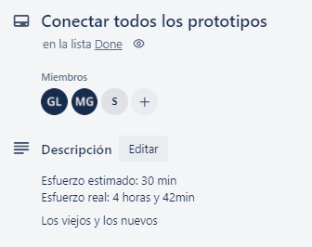
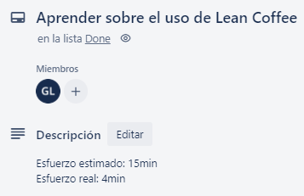
Task

Slide 3
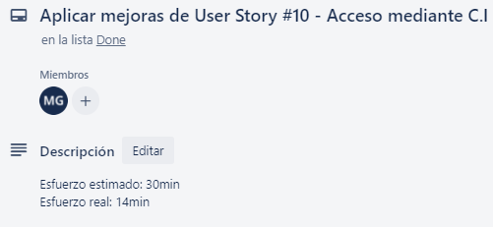
Task

